Slide 1
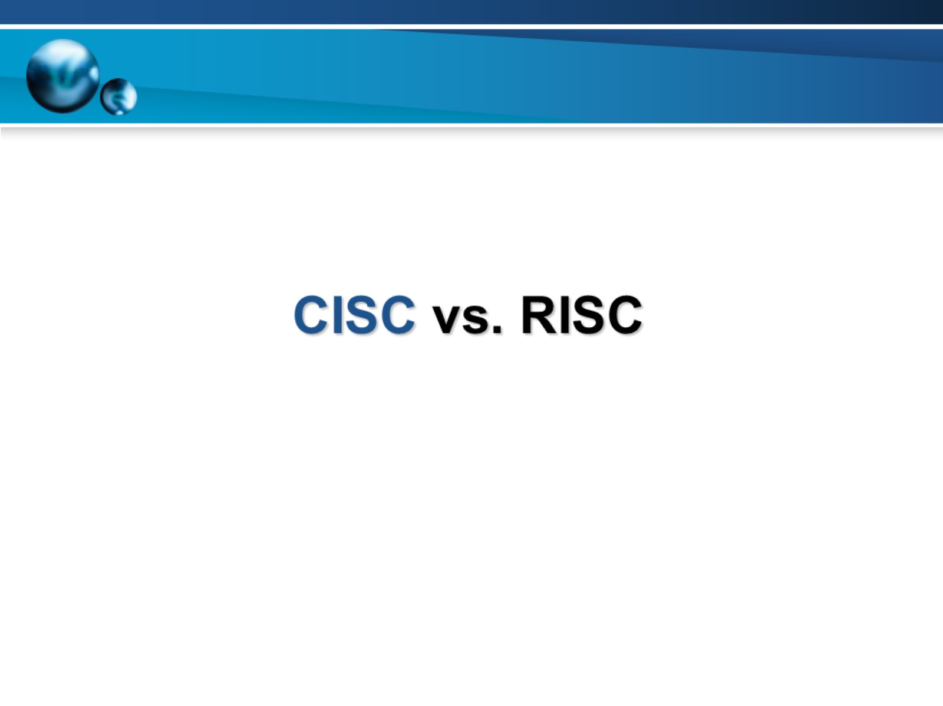
CISC vs. RISC

Slide 2
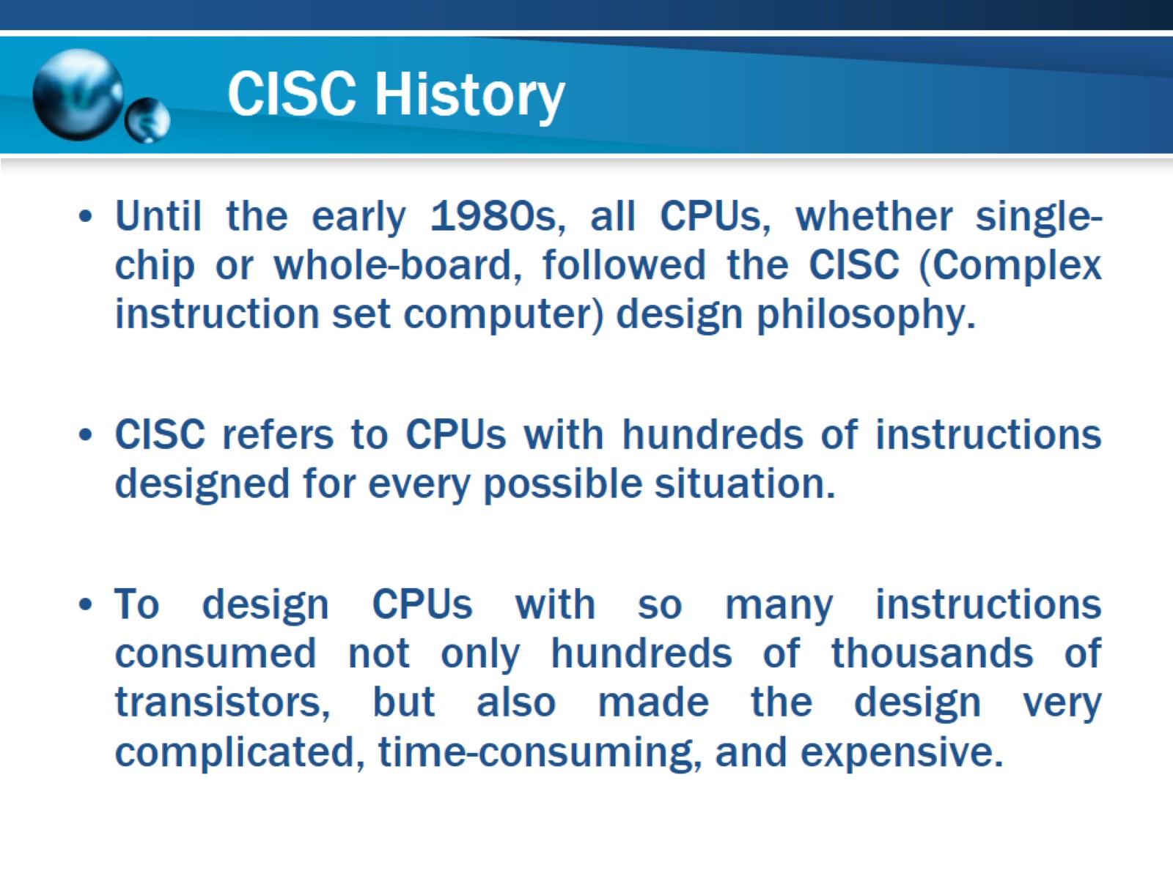
CISC History

Slide 3
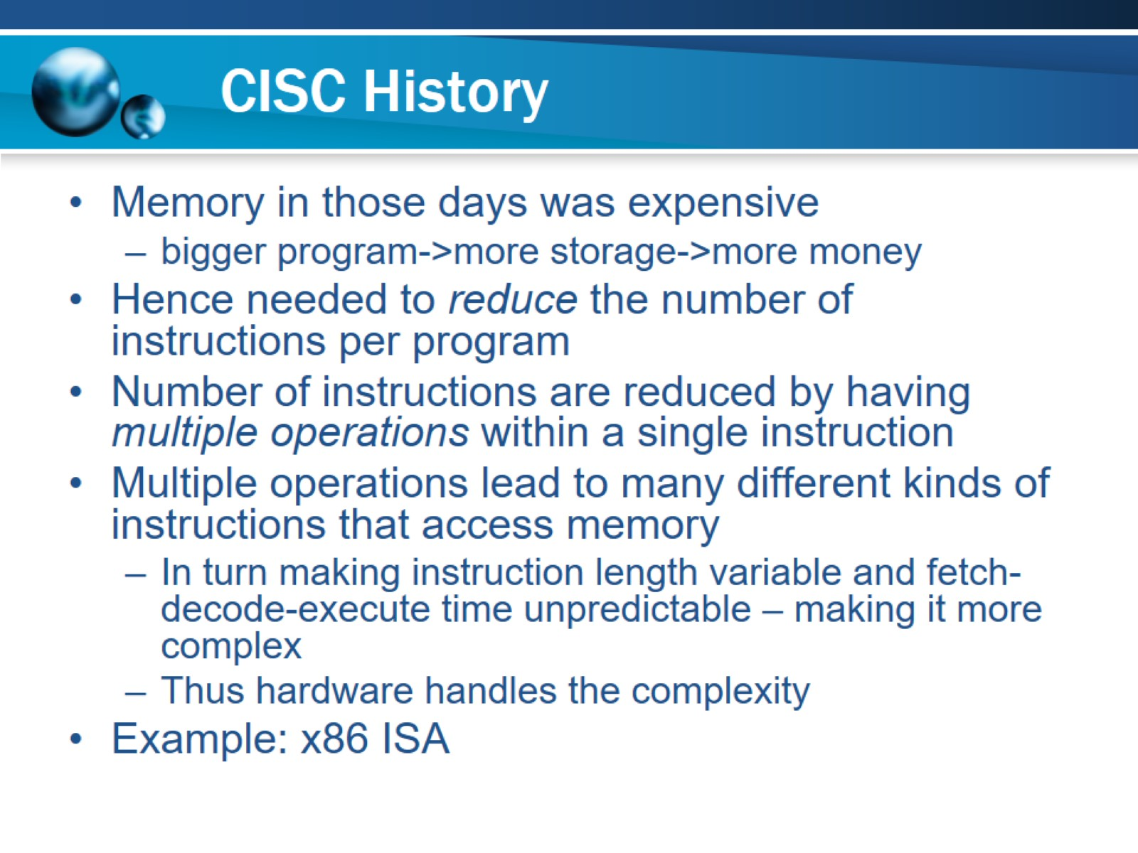
CISC History

Slide 4
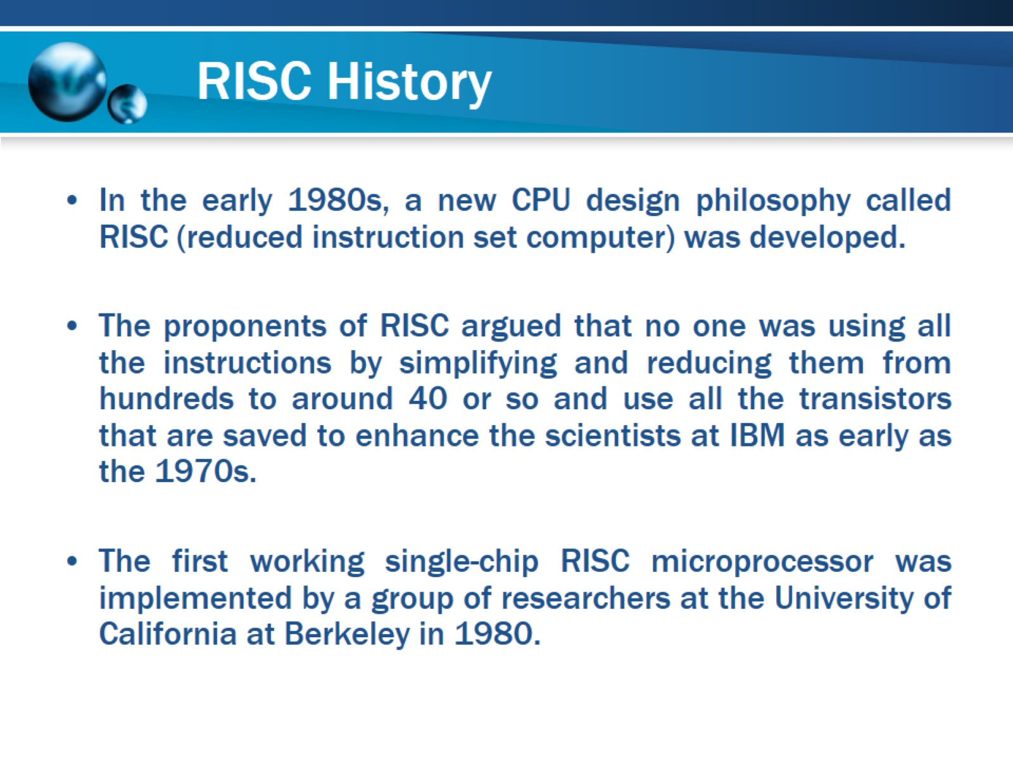
RISC History

Slide 5
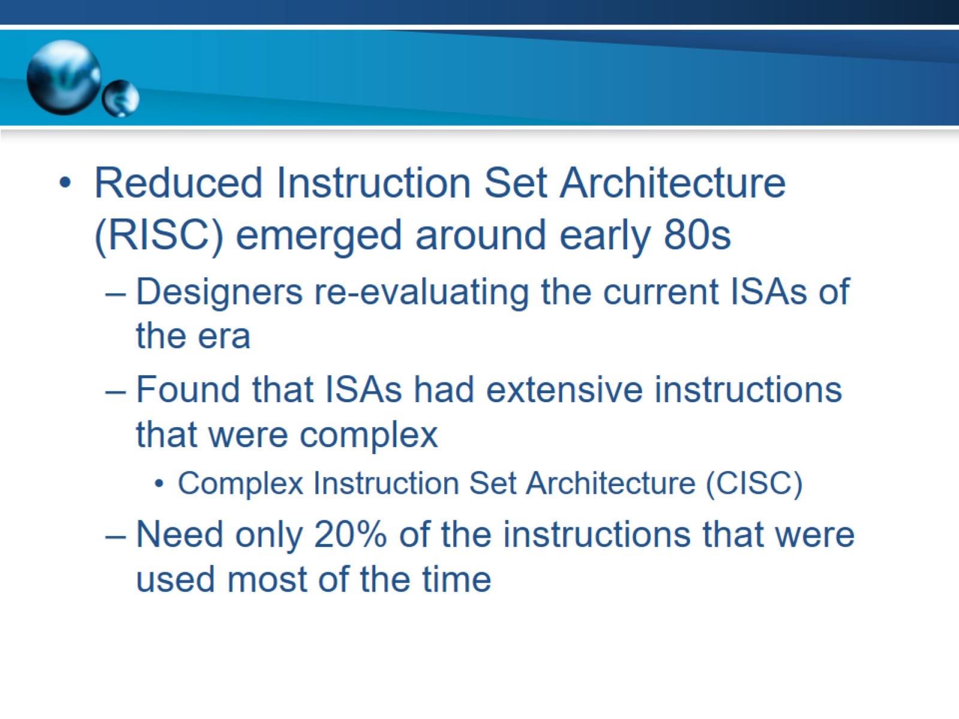

Slide 6
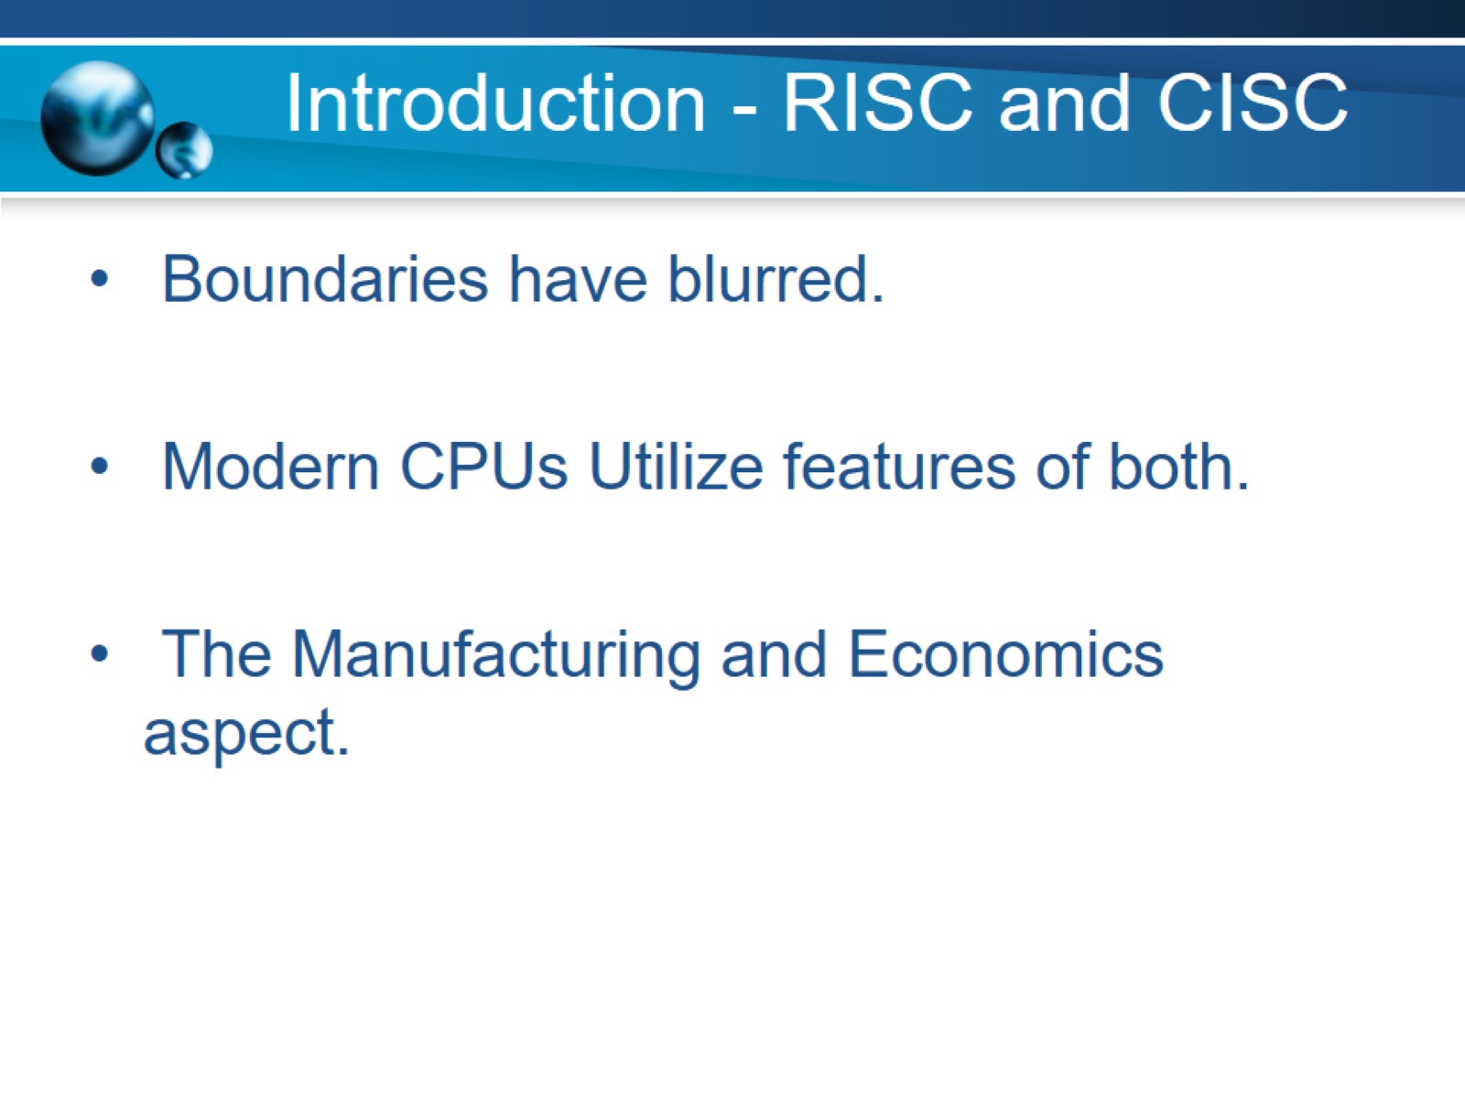
Introduction - RISC and CISC

Slide 7
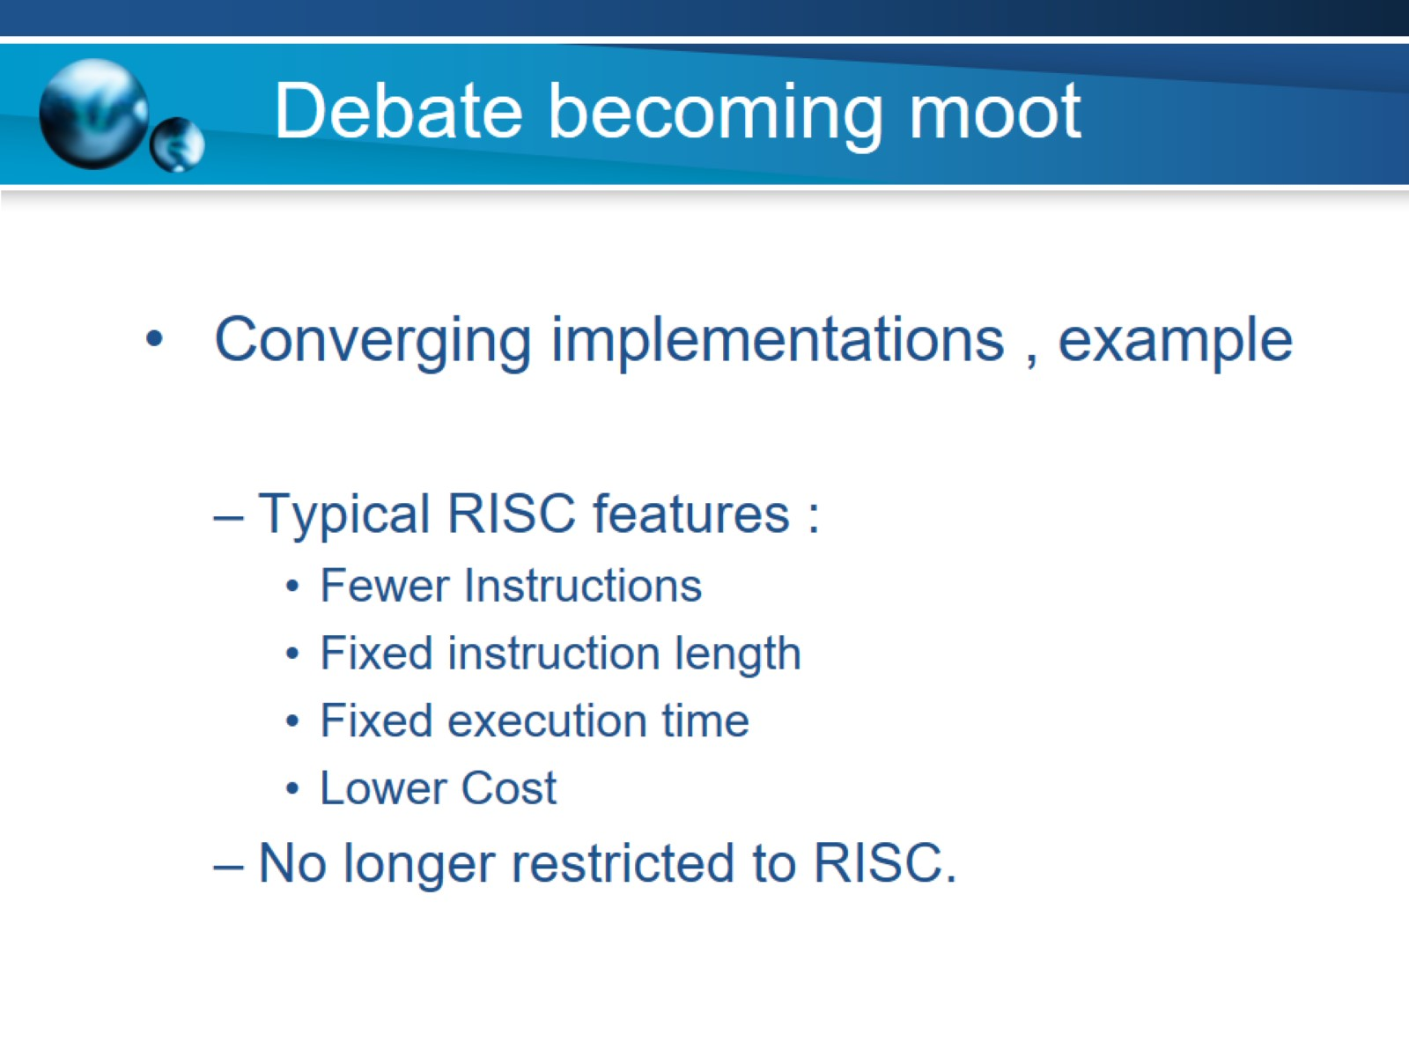
Debate becoming moot

Slide 8
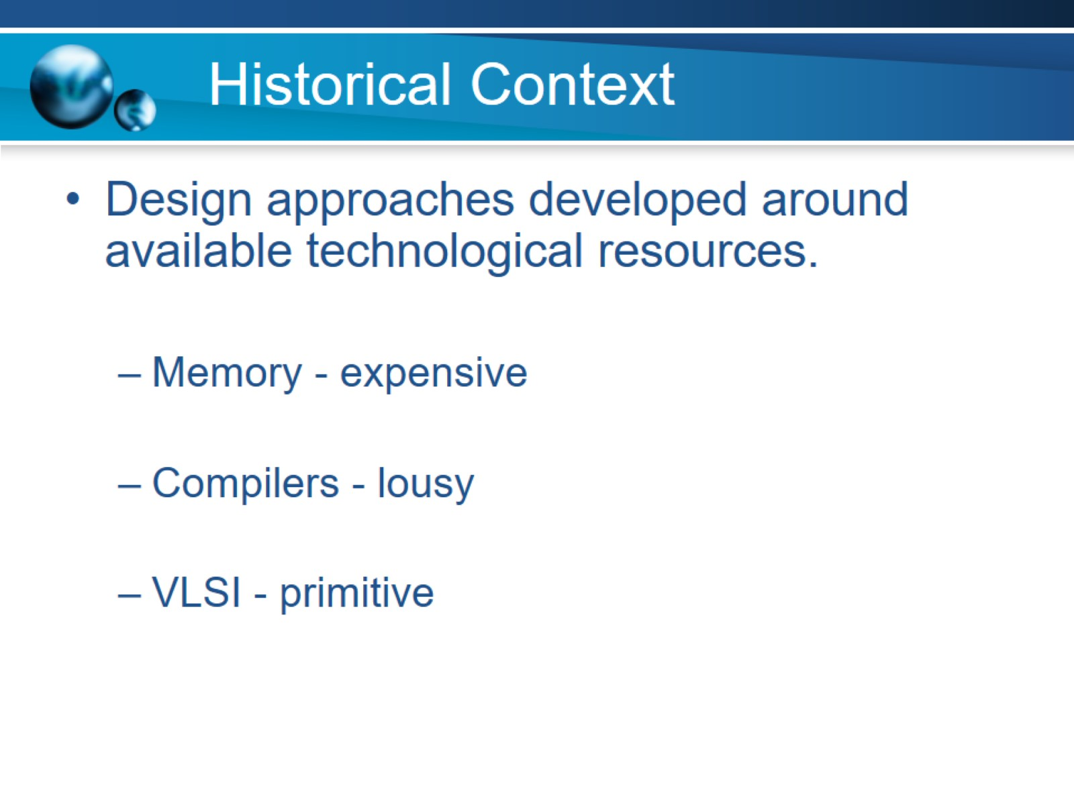
Historical Context

Slide 9
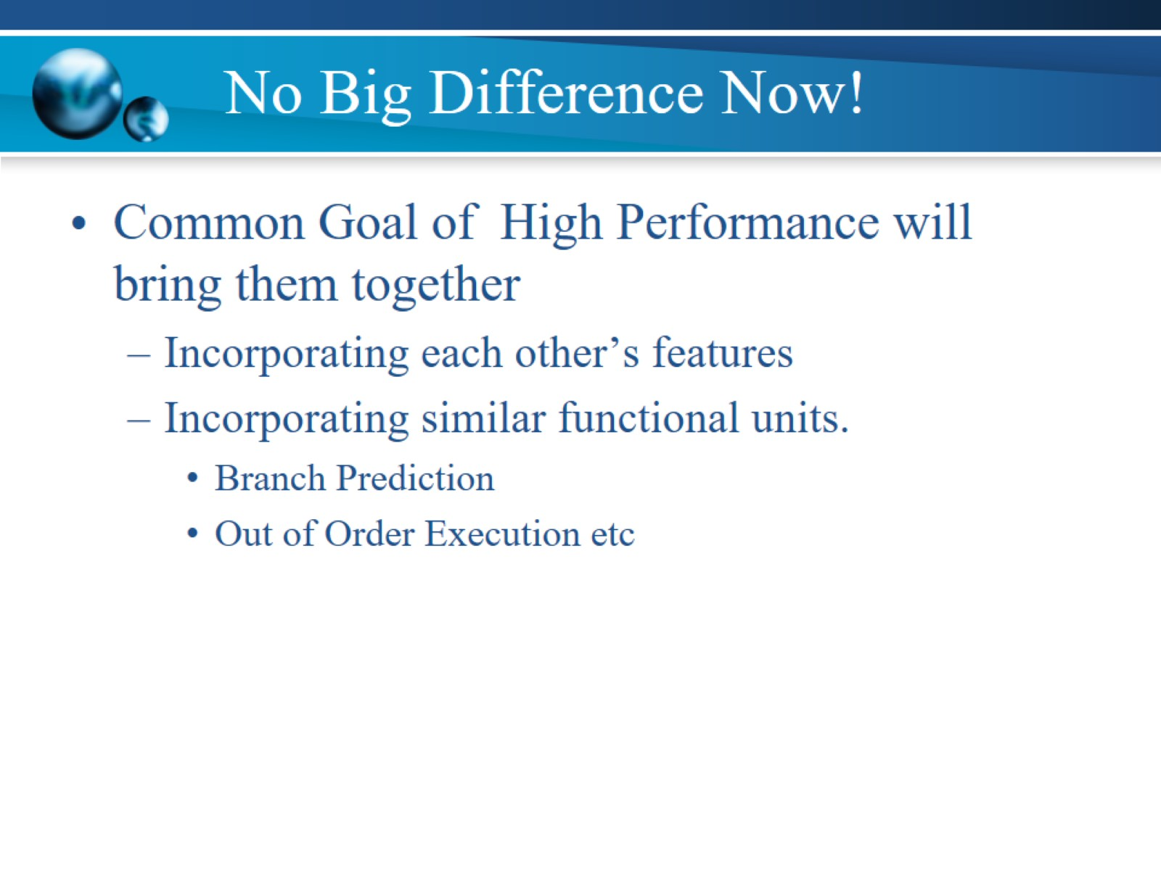
No Big Difference Now!

Slide 10
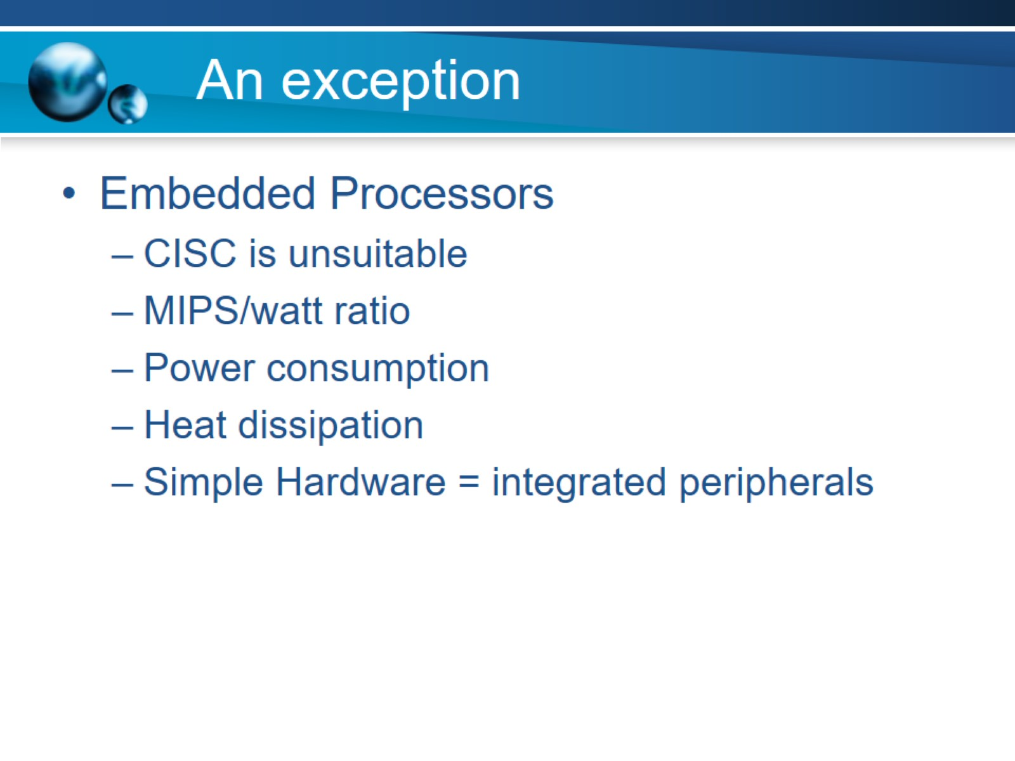
An exception

Slide 11
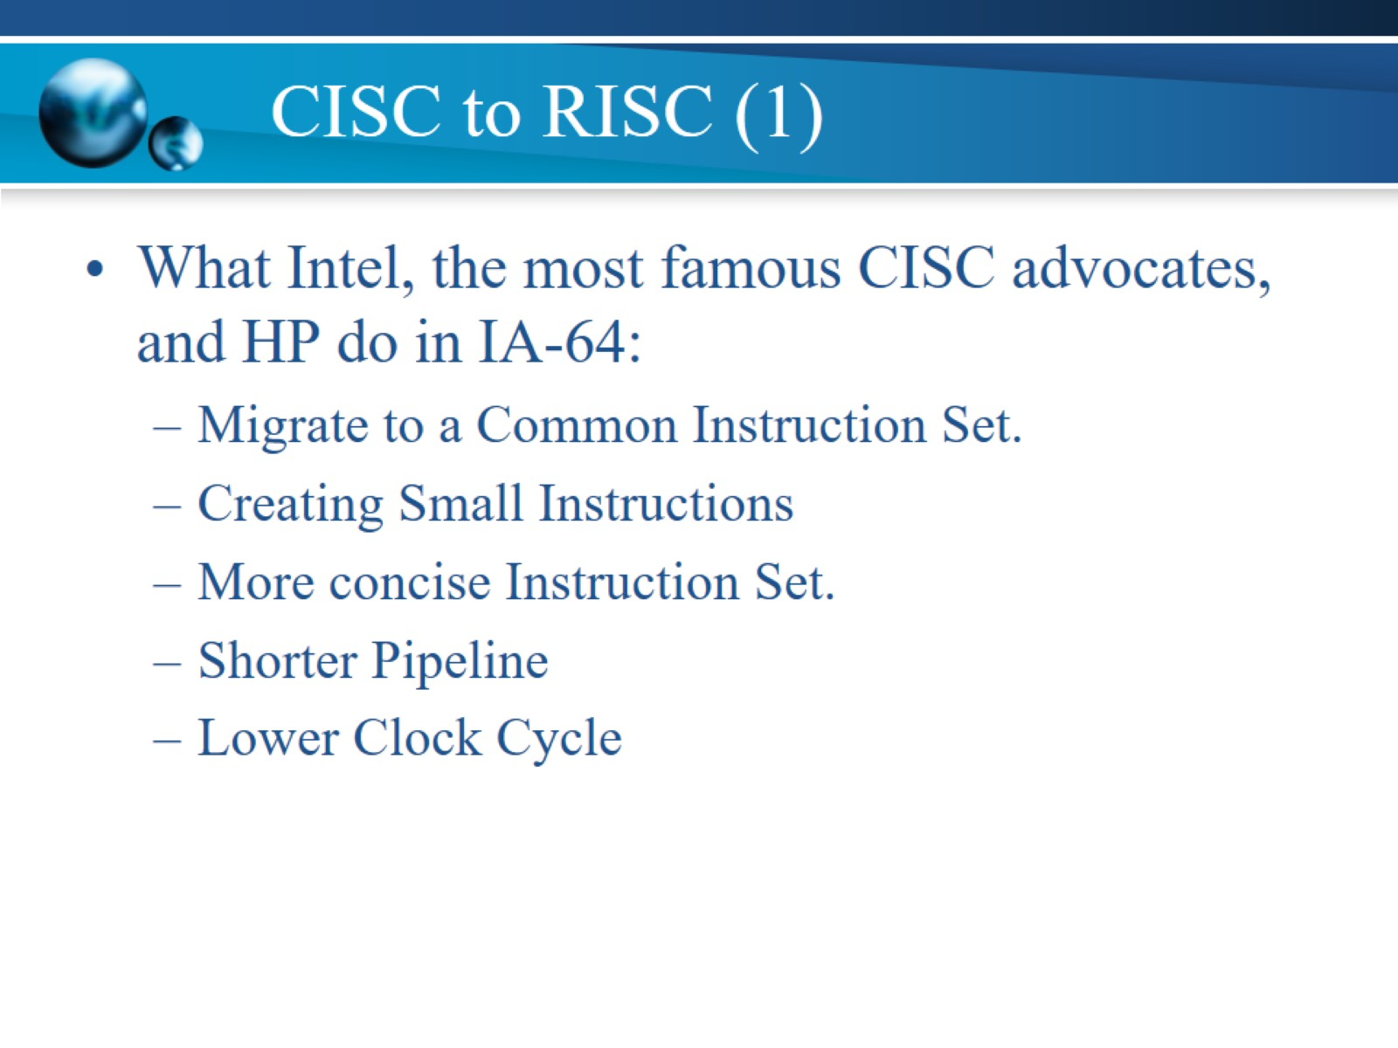
CISC to RISC (1)

Slide 12
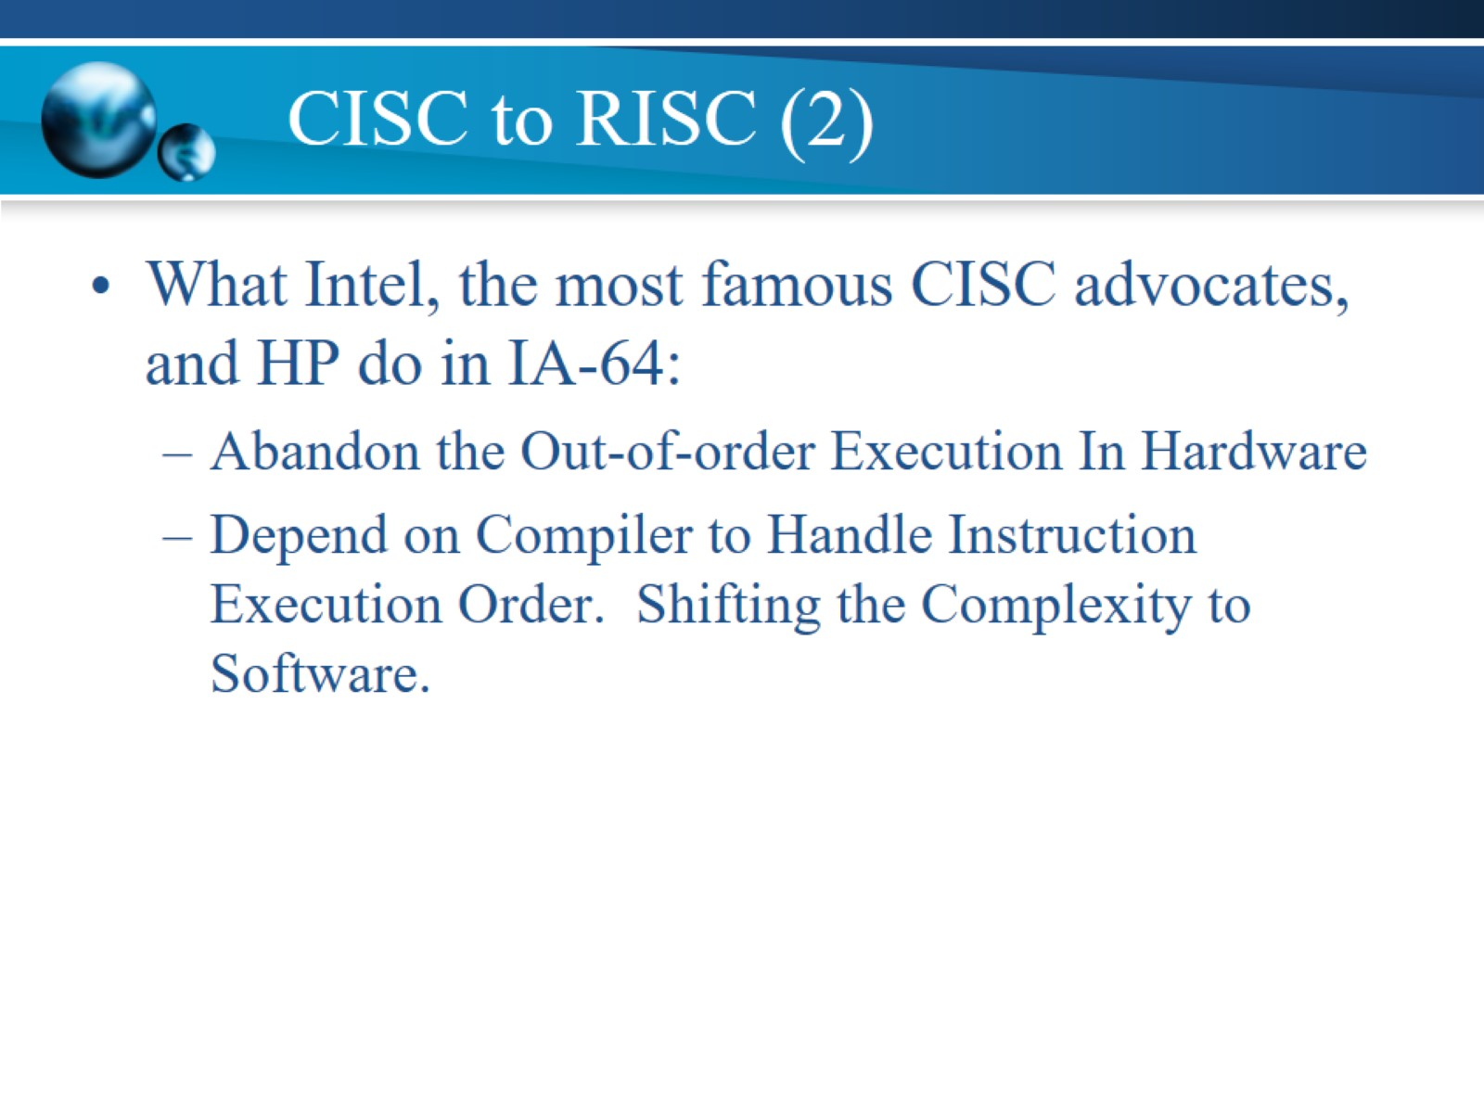
CISC to RISC (2)

Slide 13
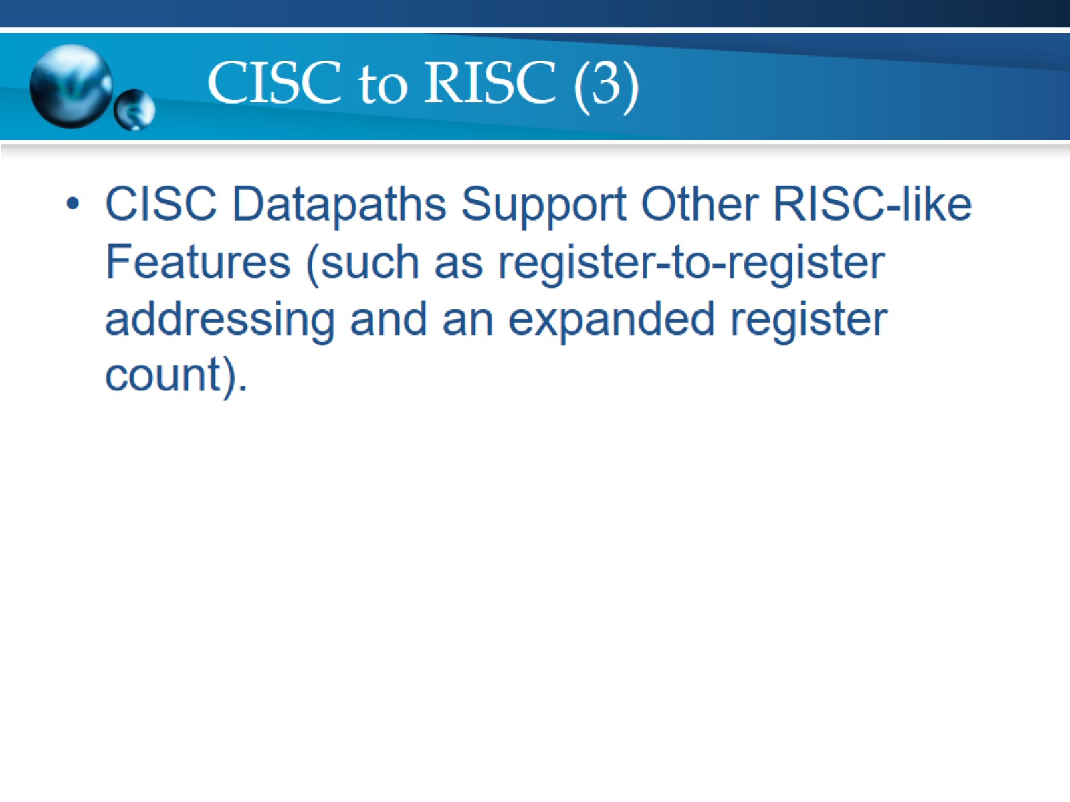
CISC to RISC (3)

Slide 14
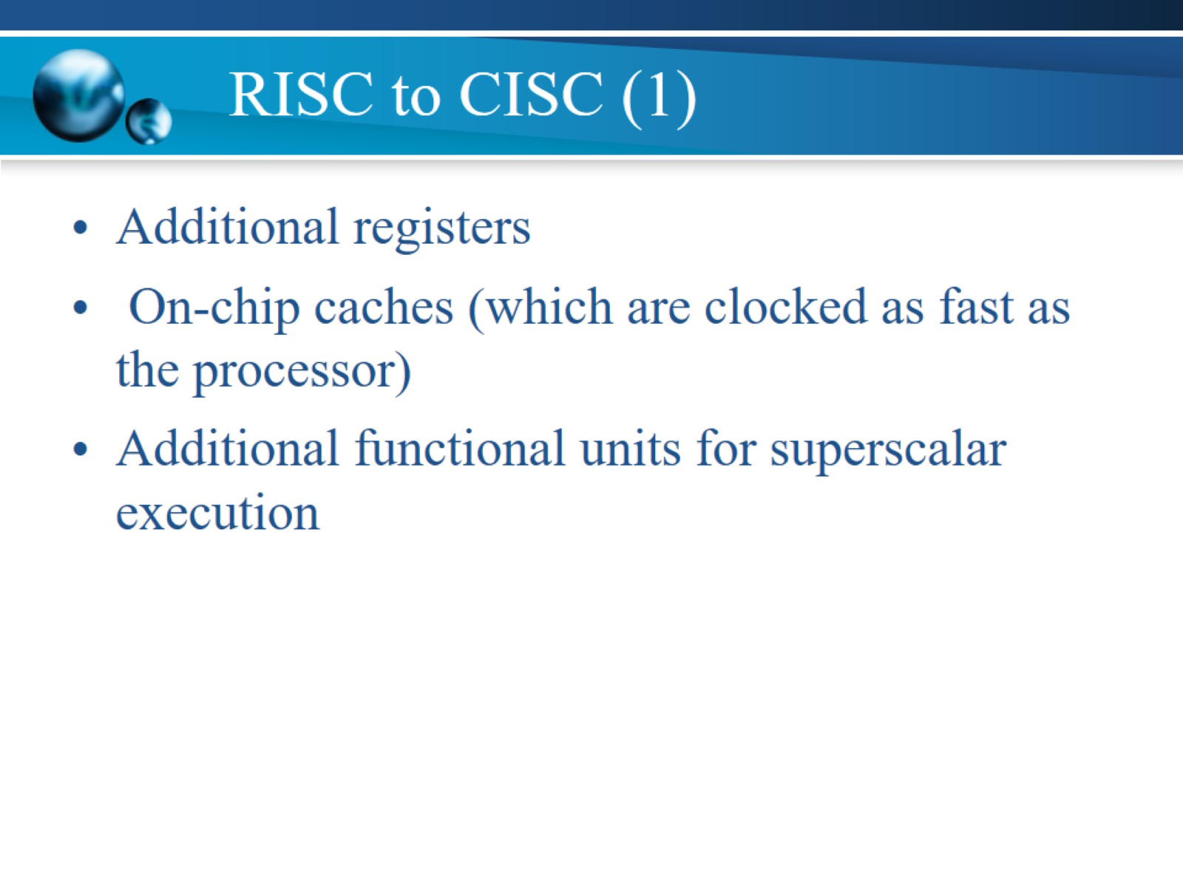
RISC to CISC (1)

Slide 15
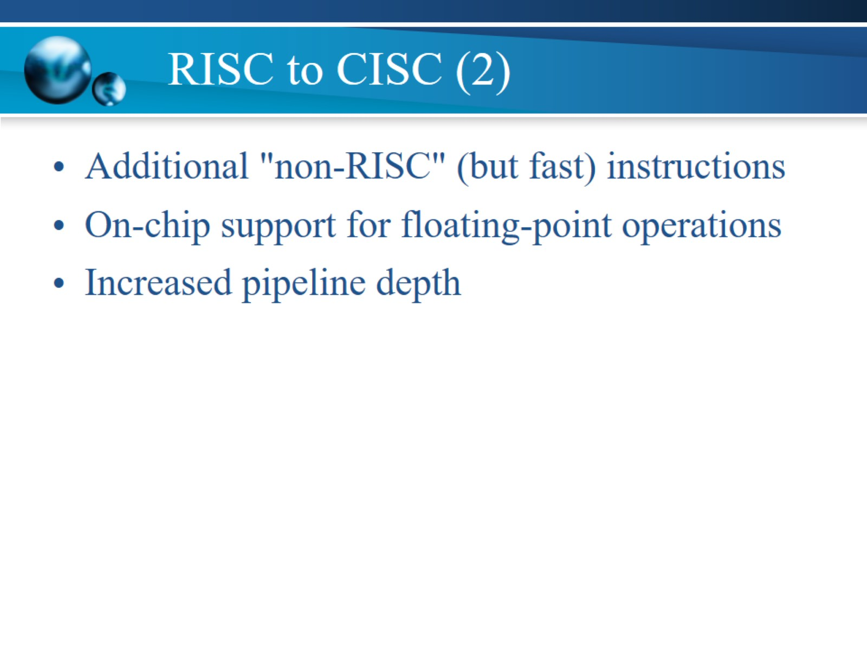
RISC to CISC (2)

Slide 16
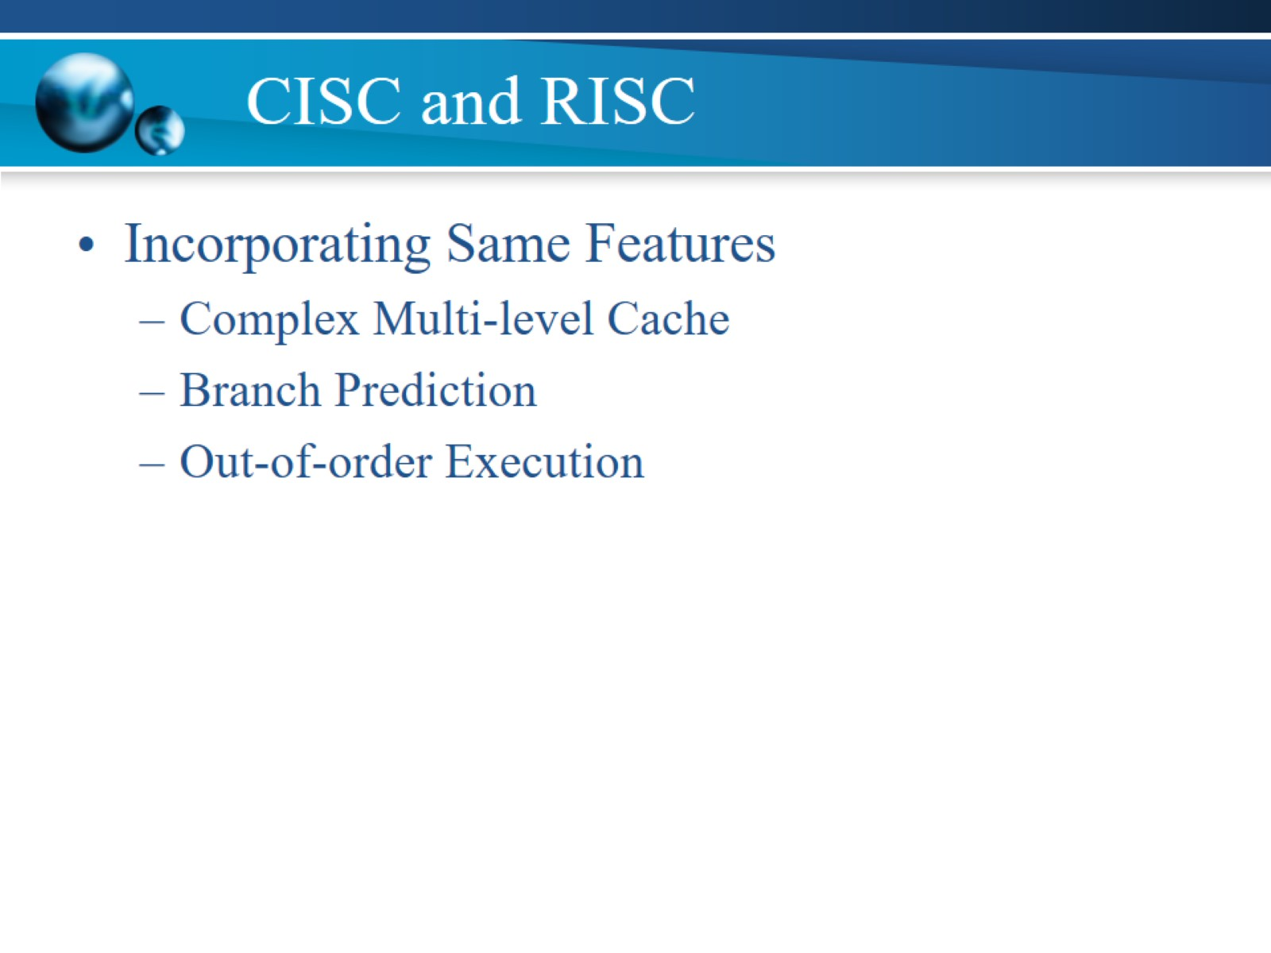
CISC and RISC

Slide 17
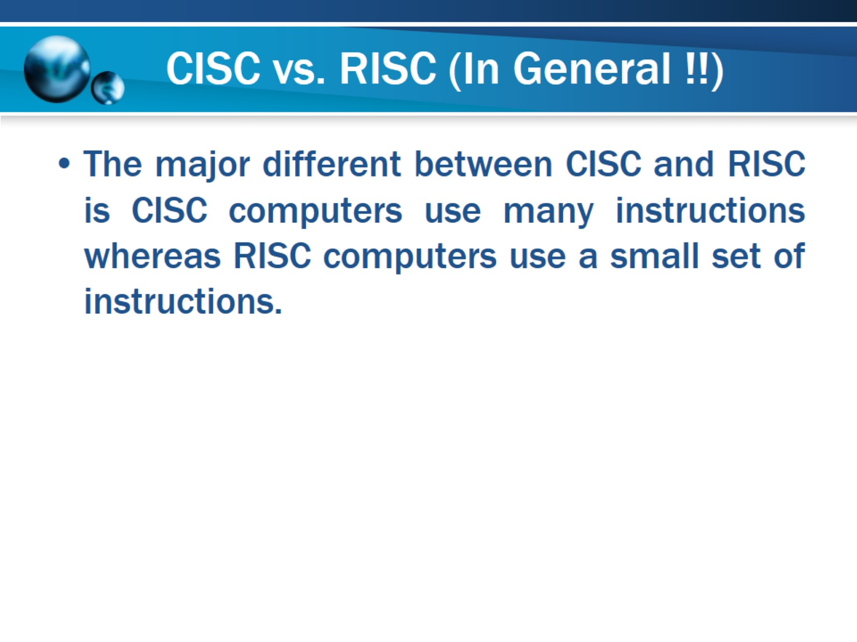
CISC vs. RISC (In General !!)

Slide 18
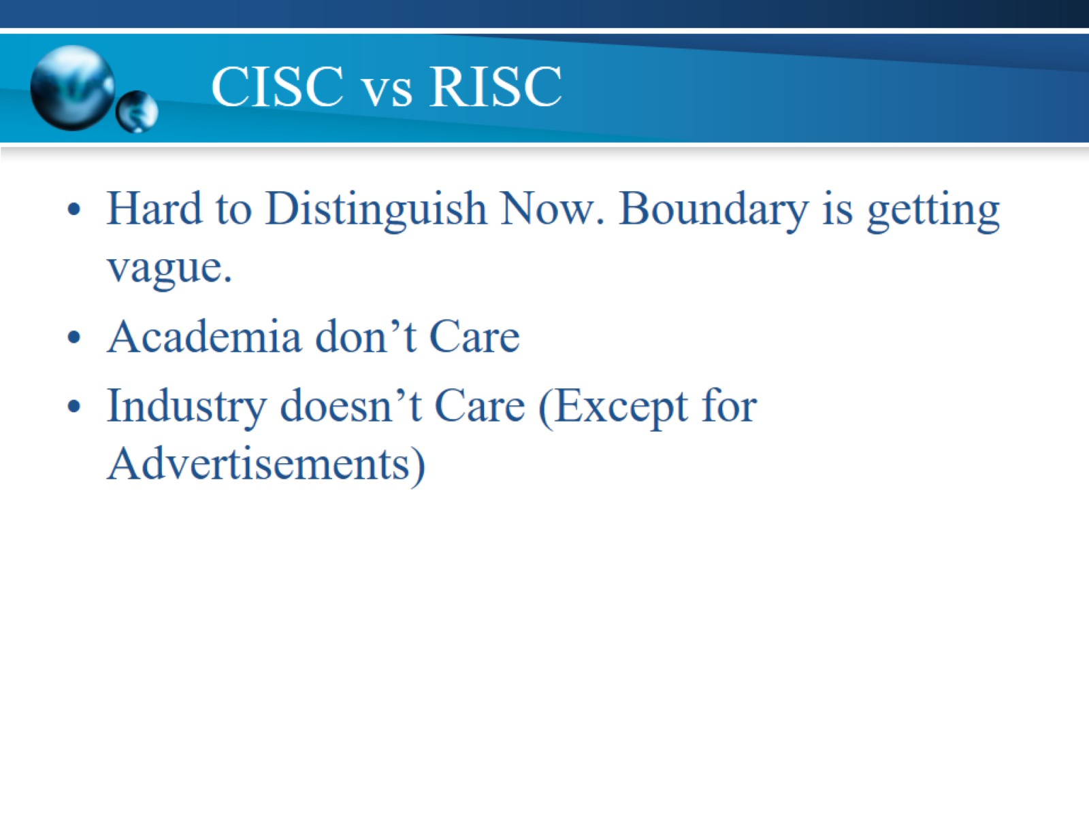
CISC vs RISC

Slide 19
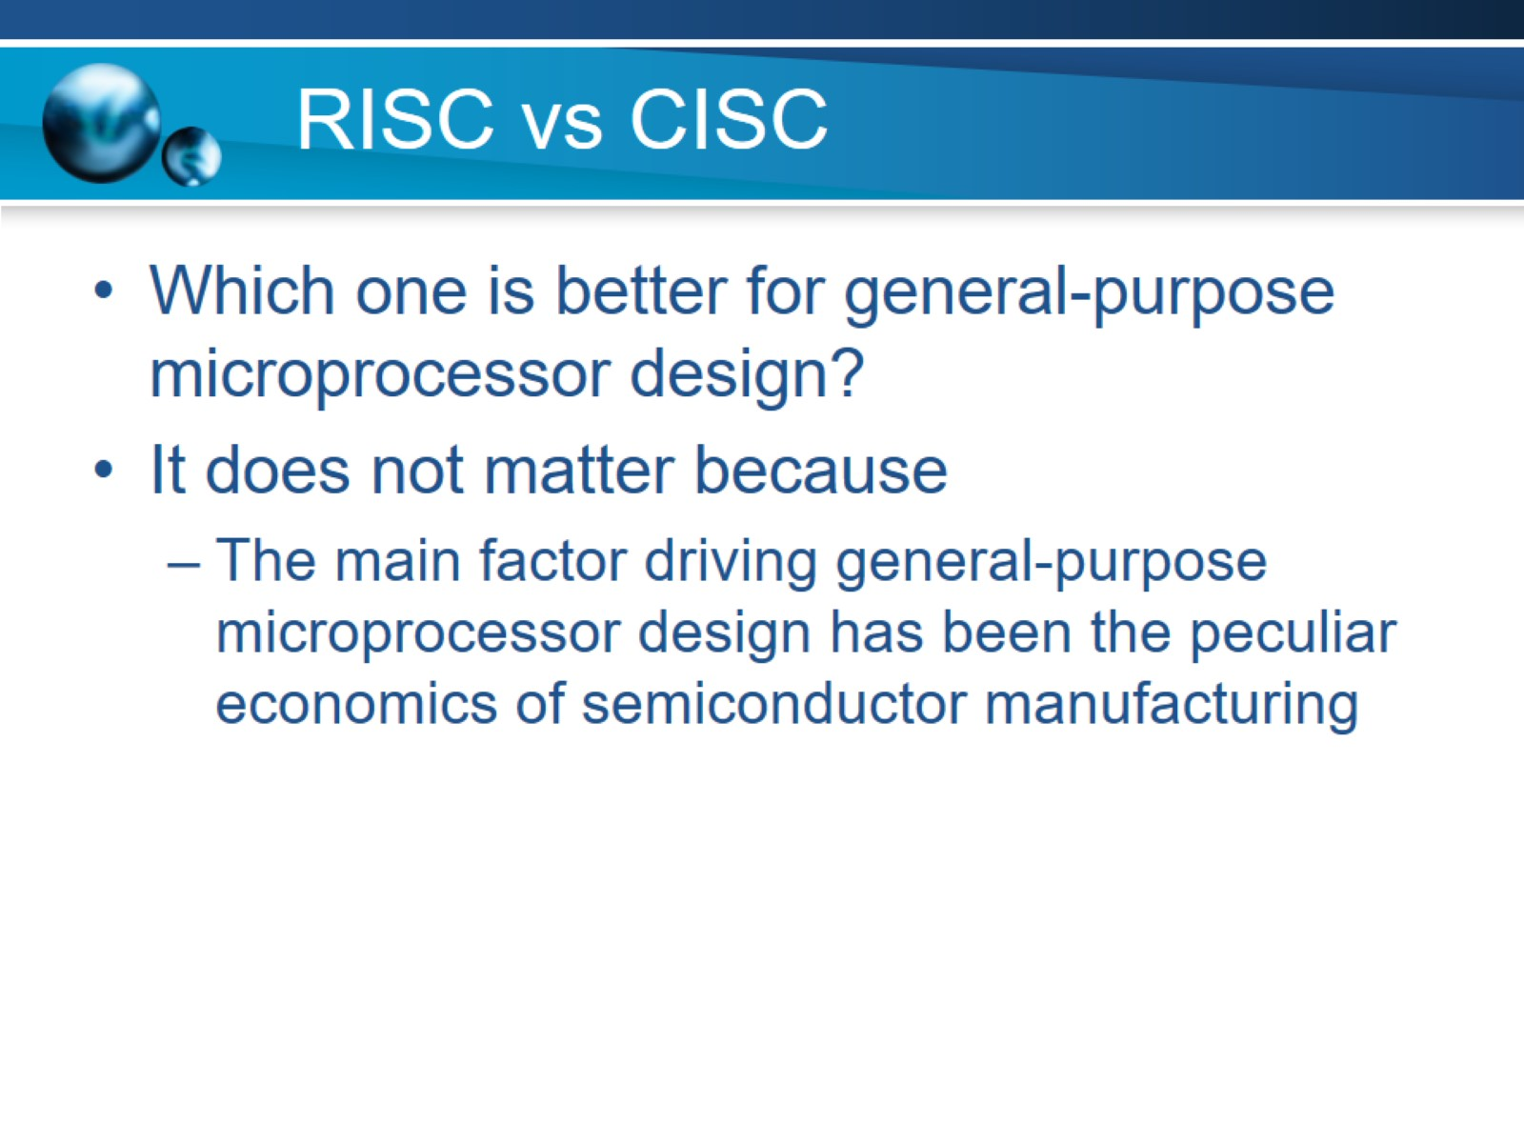
RISC vs CISC

Slide 20
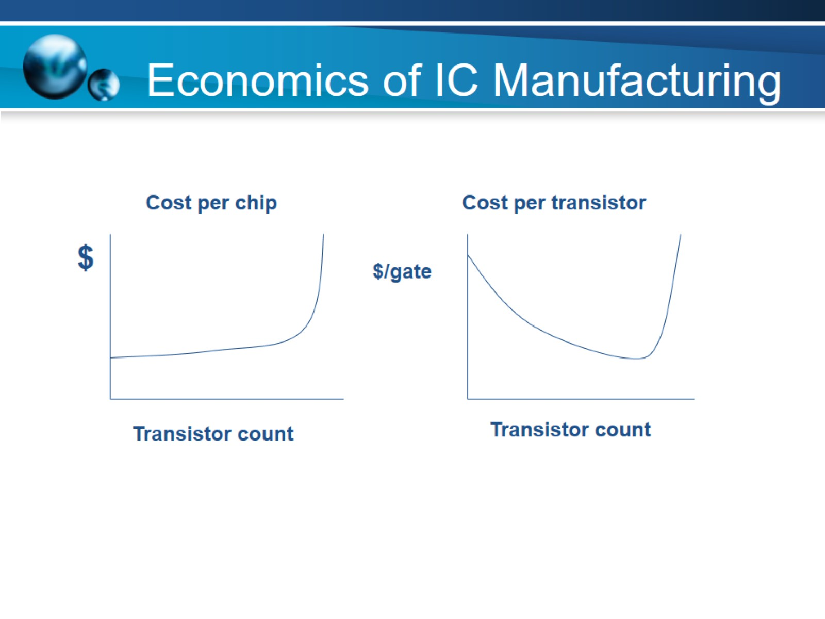
Economics of IC Manufacturing

Slide 21
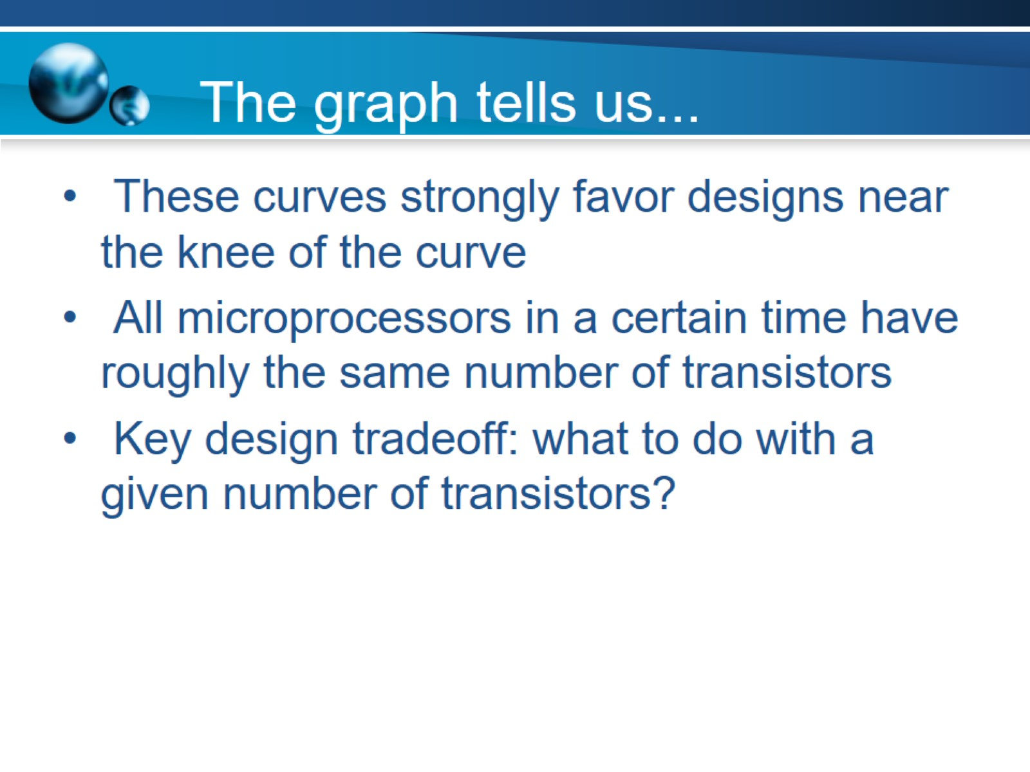
The graph tells us...

Slide 22
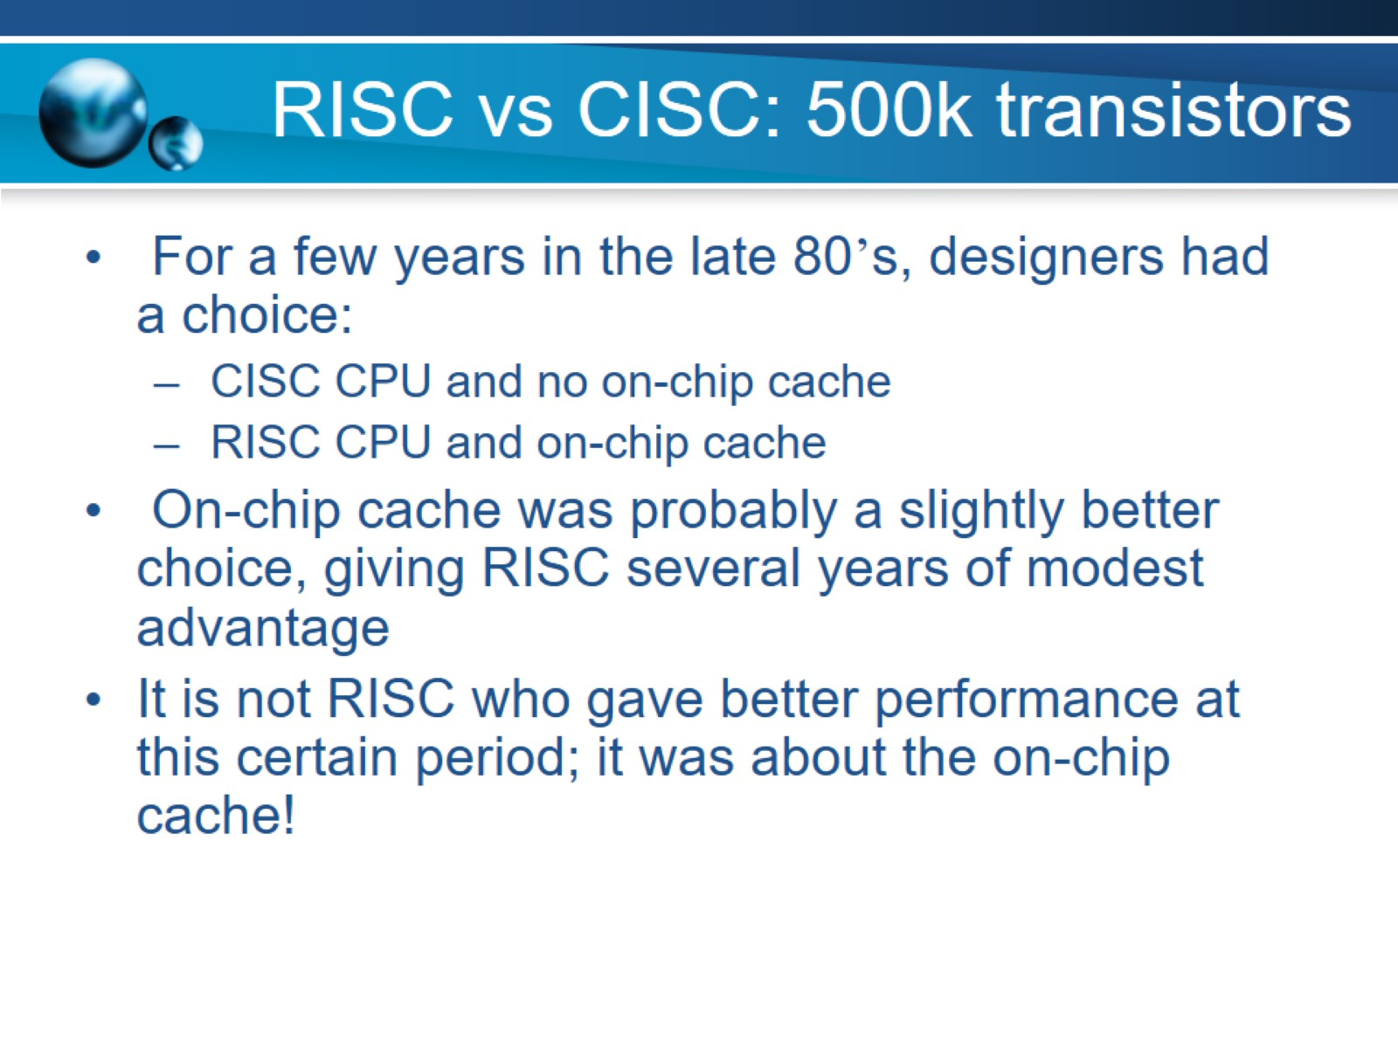
RISC vs CISC: 500k transistors

Slide 23
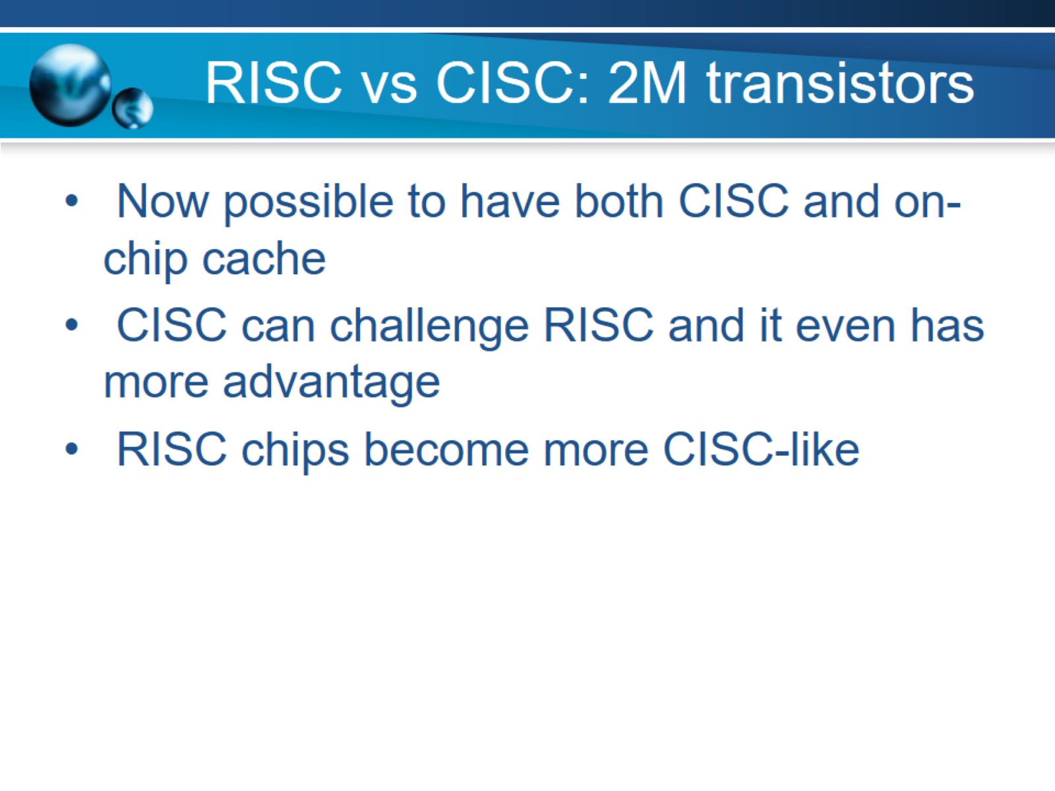
RISC vs CISC: 2M transistors

Slide 24
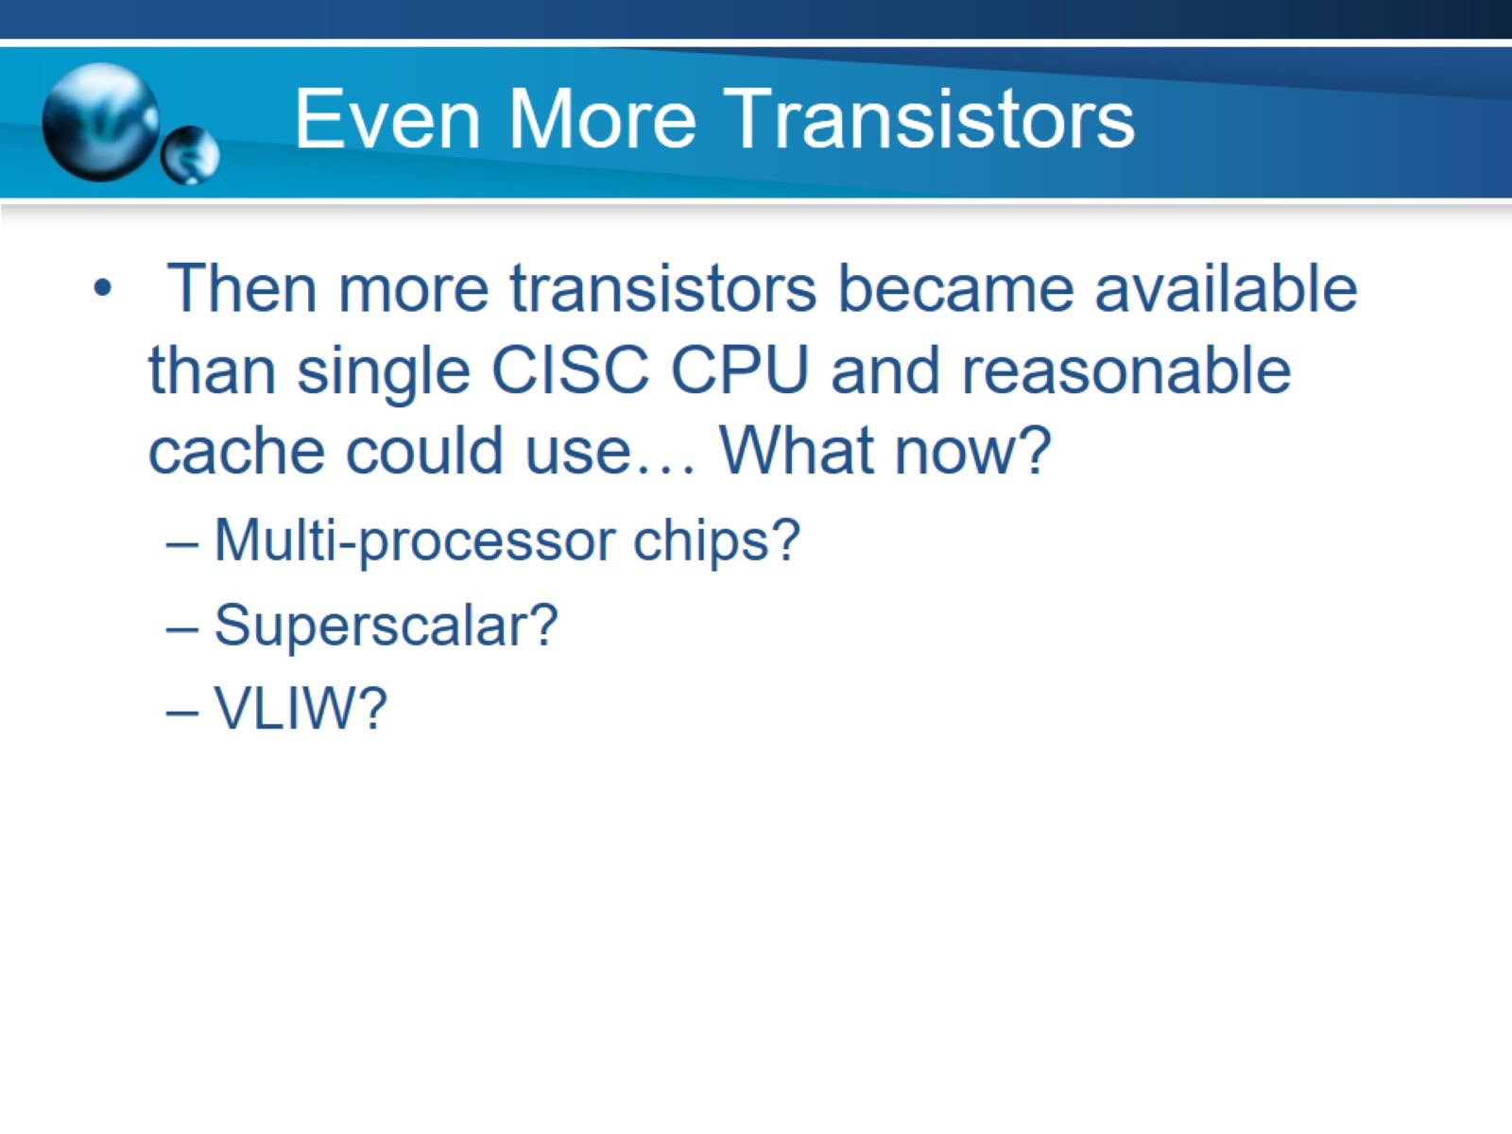
Even More Transistors

Slide 25
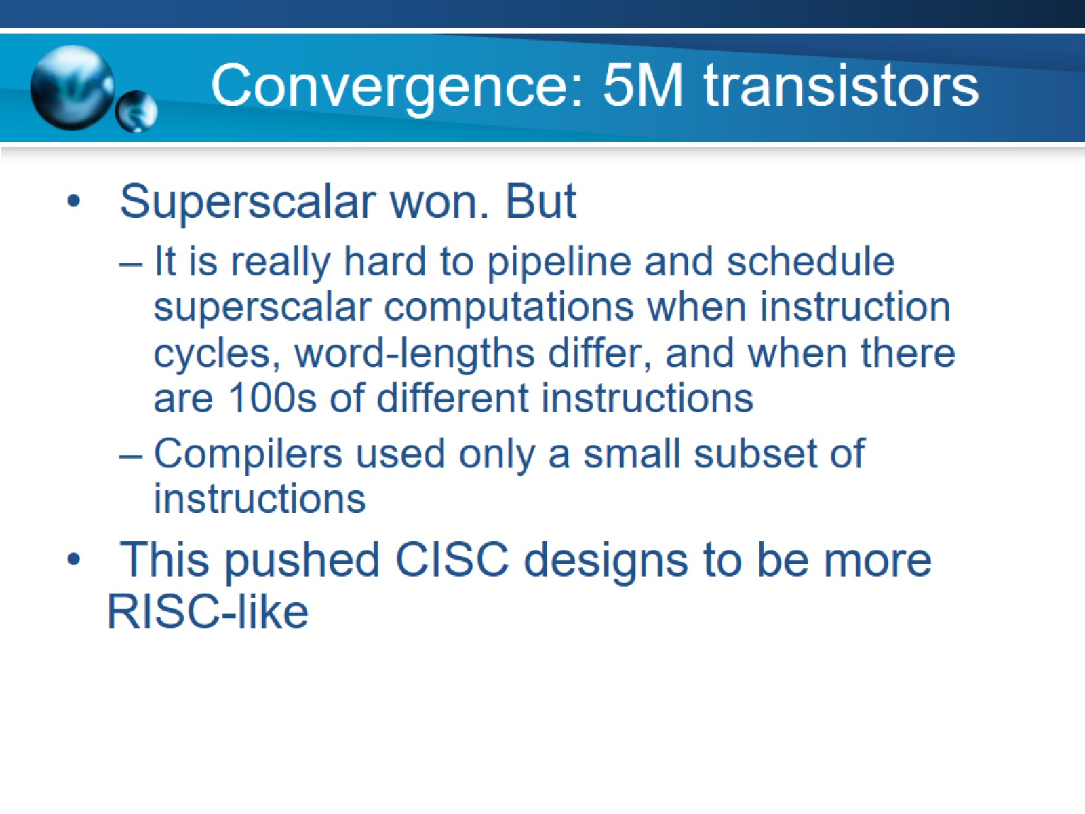
Convergence: 5M transistors

Slide 26
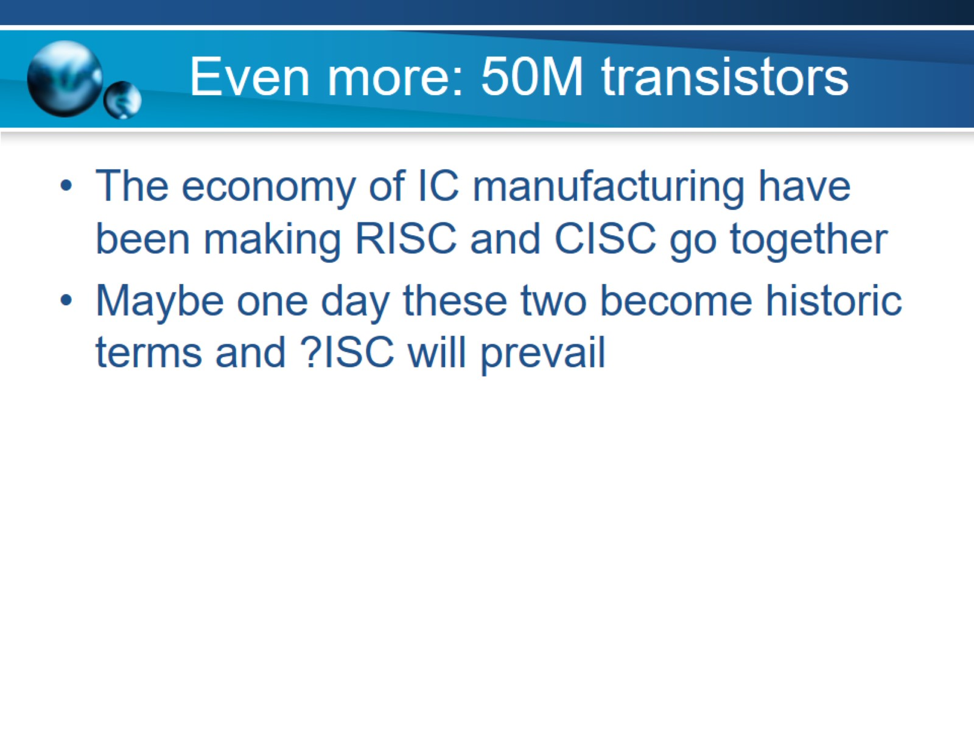
Even more: 50M transistors

Slide 27
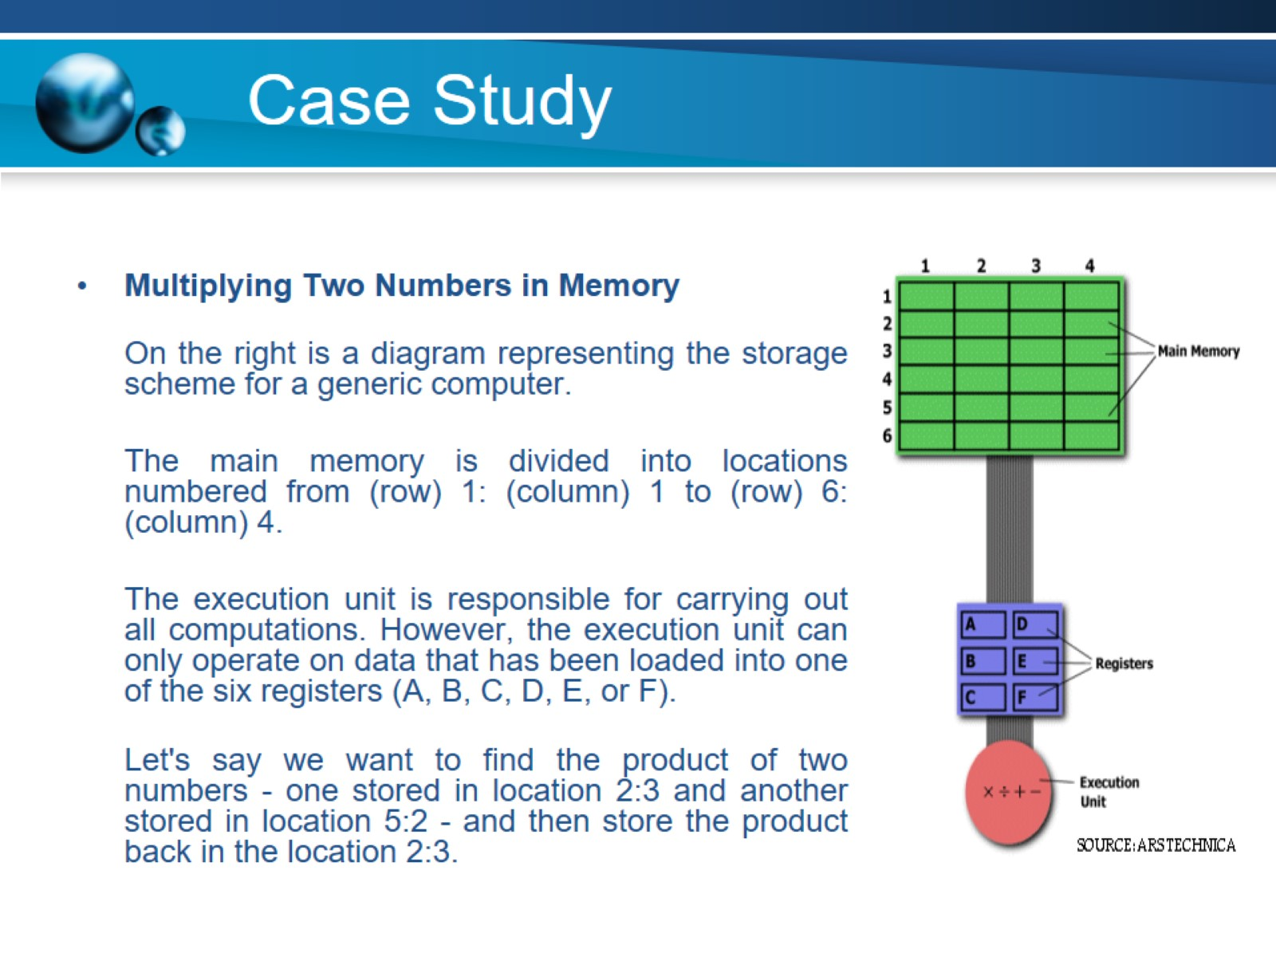
Case Study

Slide 28
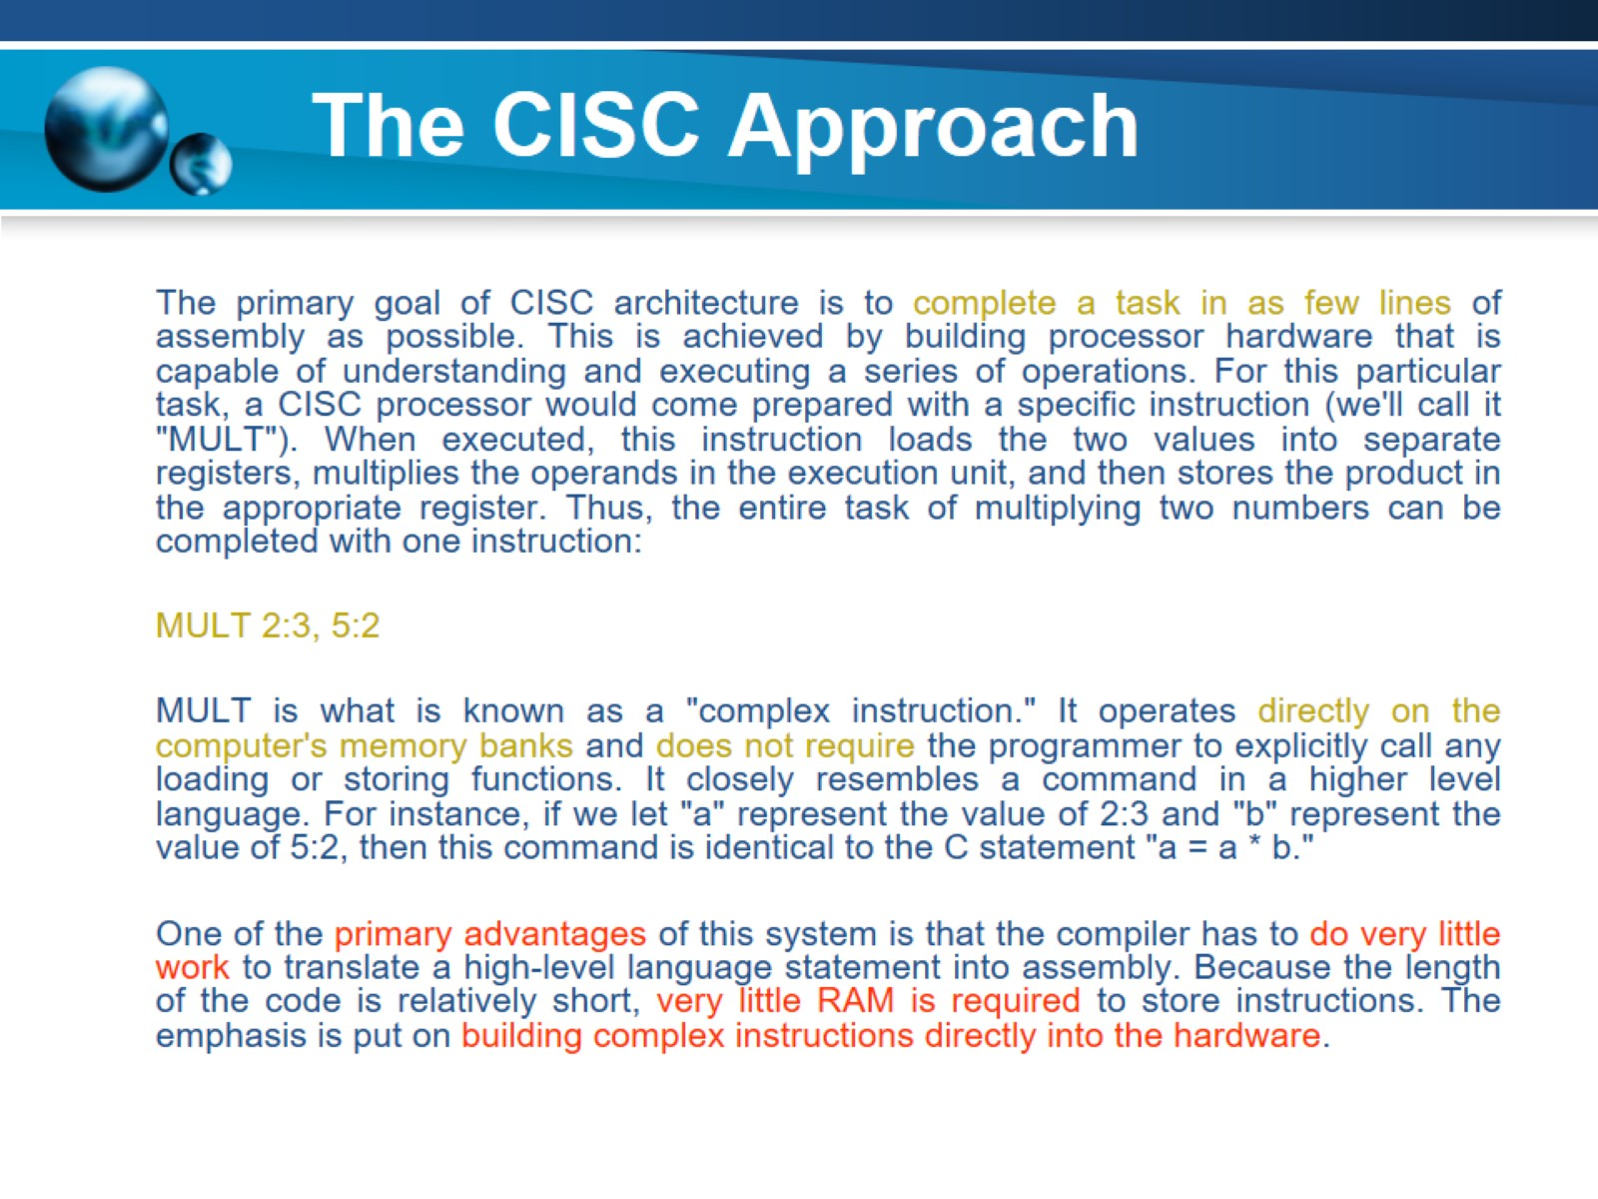
The CISC Approach

Slide 29
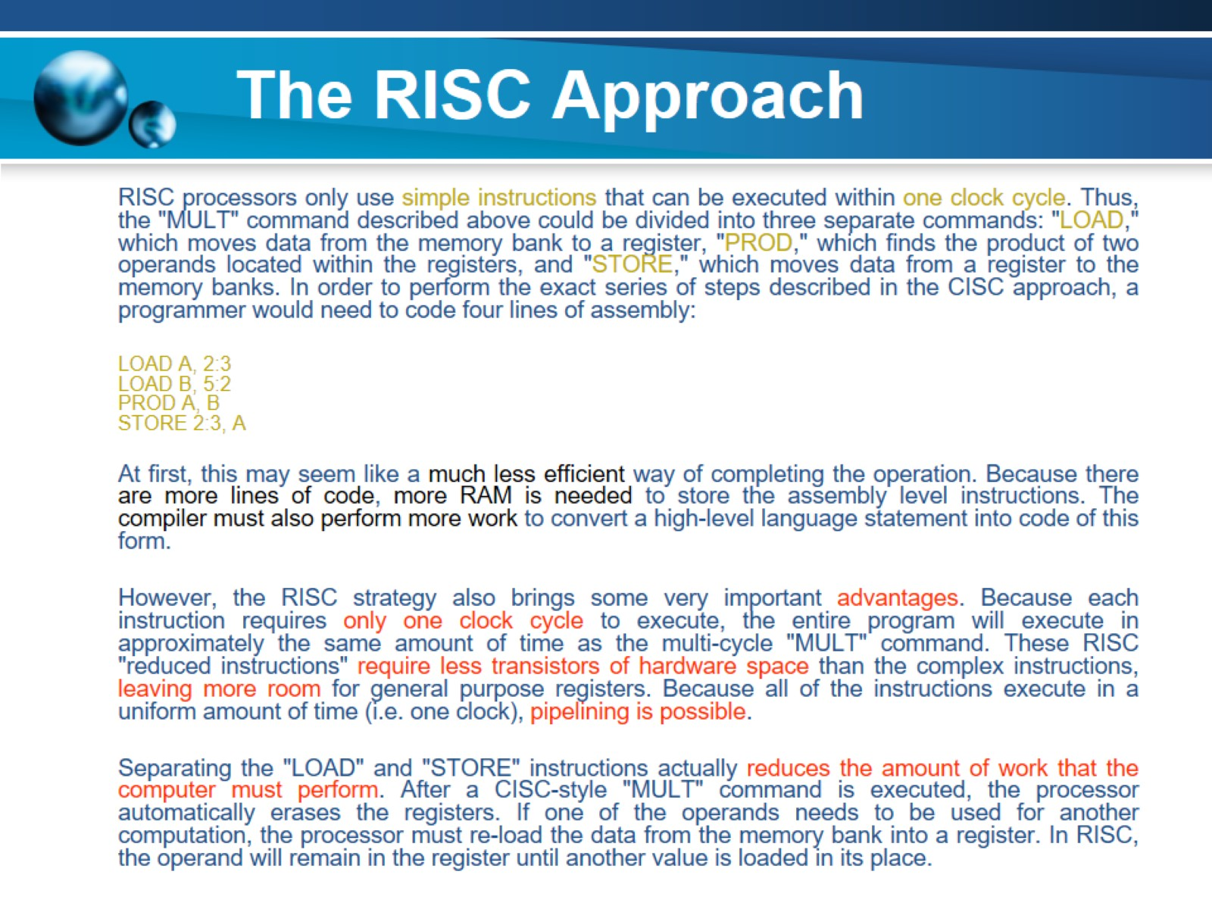
The RISC Approach

Slide 30
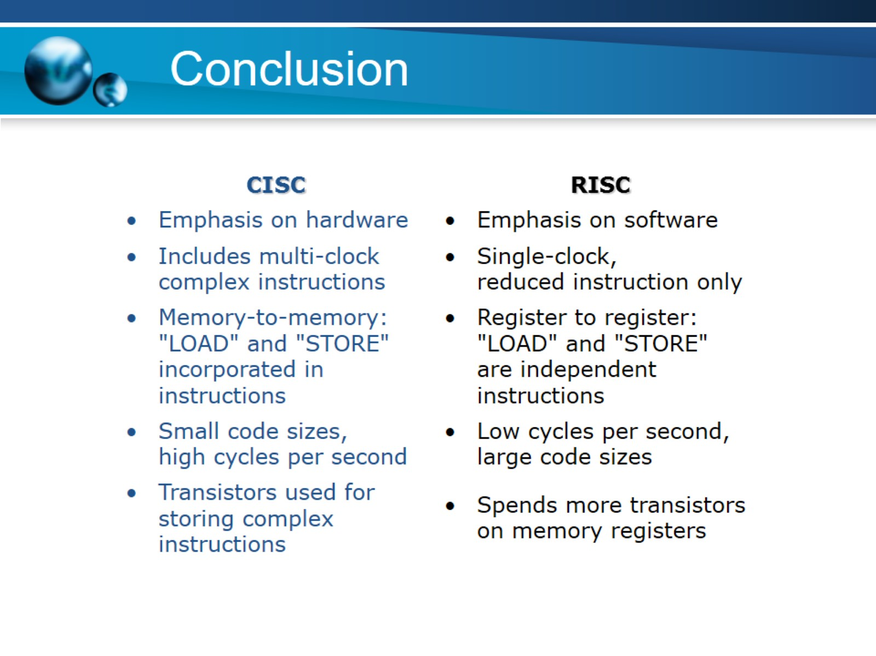
Conclusion

